Slide 1
Loan Default Risk predictors
Ashutosh Singh
Jaysree Mangalagiri
DS C15

Slide 2
Problem Statement:
UpGrad Financers want to understand the driving factors behind loan default, i.e. the variables which are strong indicators of default for its portfolio and risk assessment.
They provided us, jAsh Digital Initiatives, with their data in relation to:
Previous applications
Current application
“Column Description” (explaining the data)

Slide 3
Our Goal
Find patterns present in the data to ensure that the applicants capable of repaying the loans are not rejected.

Slide 4
Process
Derived Metrics
important but…
Treating missing values
Dataframe by data types
Balancing 0s and 1s
Categorical DA
Analyze numerical data
Merge pre-application data
Analyze merged data
Report insights

Slide 5
Recommendations
UpGrad Financers will have to do a through back ground check before approving the loan. Check Address and length of employment.
Check for type of employment and education level, applicants with lower education levels and working in unorganized sectors tend to default more
Credit score is a good indicator of the defaulting probability
Make documentations a priority

Slide 6
The data, analysis and the proof

Slide 7
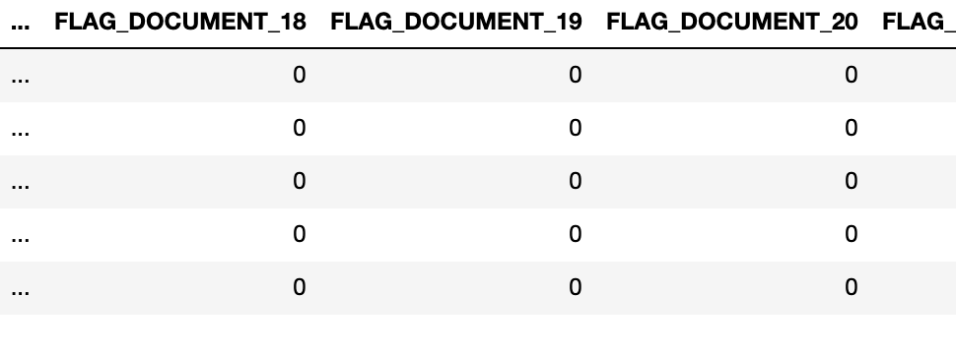
Derived Metrics Columns versus clusters
For example. There were a cluster of 21 documents that we reviewed and found only one of them to contain ALL the required information
we decided to wait to deal with missing values as there were columns that we determined to be critical for the analysis but had over 50% missing information.

Slide 8
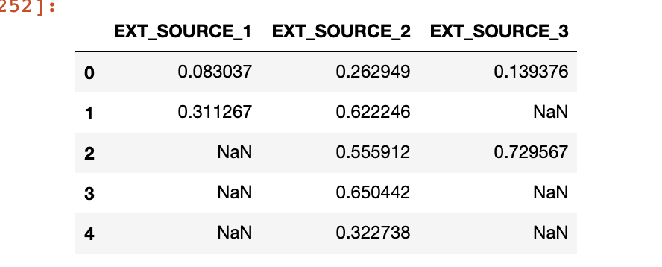
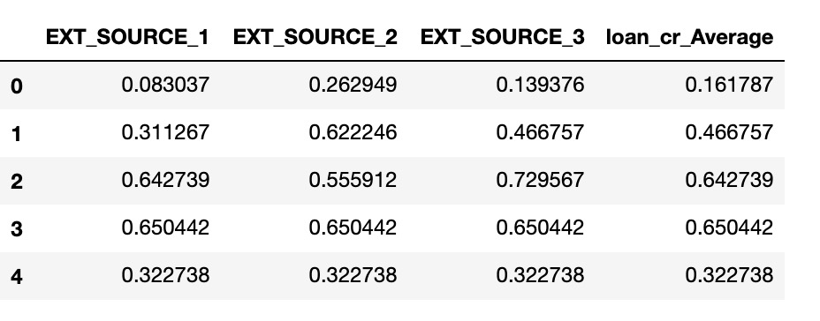
Credit score
It is a common practice to take the min., of at least three credit scores, but we thought it is not a fair practice, so we took the average.

Slide 9
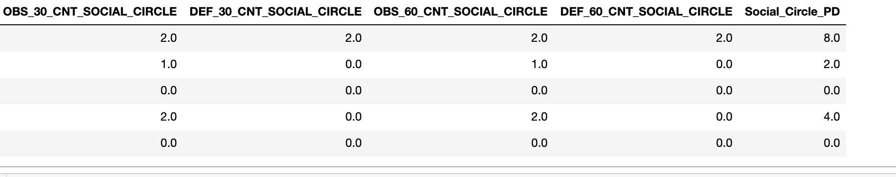
KNN and risk level
on researching various credit granting institutions it turns out that a person having people who have had late payments in their social circles is one of the important indicators of the applicant having higher default rate.(Much like what machine learning calls KNN).
So we summed up the applicant’s “SOCIAL_CIRCLE” information and called it the level of risk, the higher the sum the higher the risk of default

Slide 10
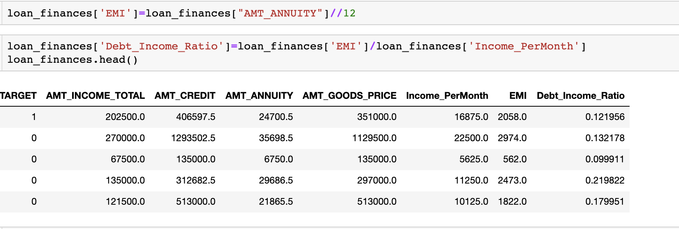
Factors influencing default rate investopeidea
According to Investopedia the debt-to-income ratio and credit score the top indicators of a person defaulting on a loan

Slide 11
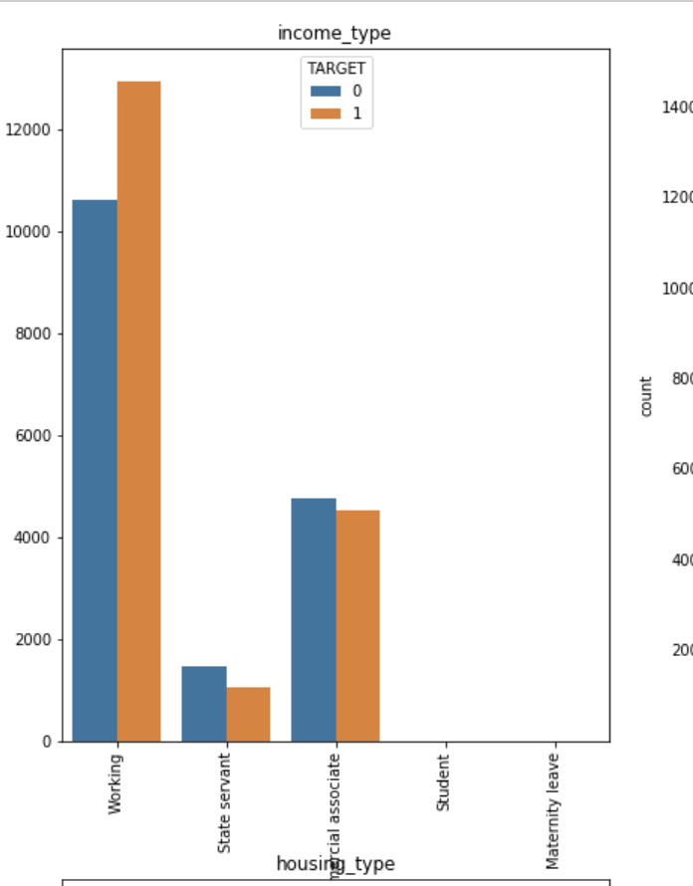
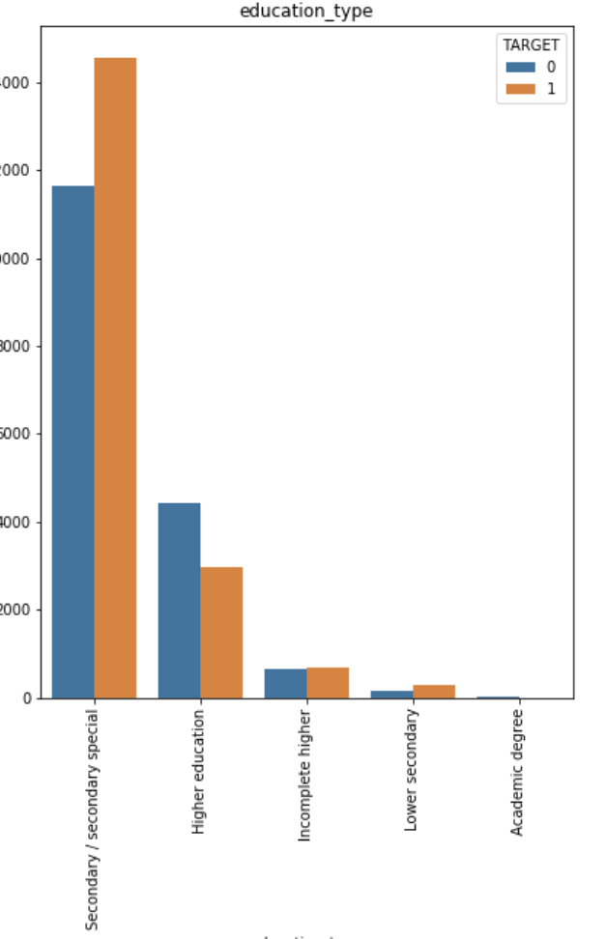
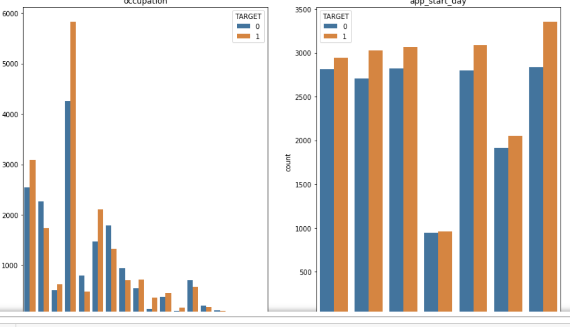
Categorical Data Analysis
Assumptions
The data represents personal loans offered by financial institutions
Each applicant provides the required data to get the loan
The financial instituting has put in good efforts to report quality data After studying the categorical data displayed in the bar graphs the following can be proposed

Slide 12
Categorical Data Insights
People that do not own a car get more loans and within those that don't have a car tend to default more often. This might indicate that the loan is intended to purchase a car. (Assuming do not have a car == don't own a car)
People who own "reality" tend to default more often than not, again indicating that they might be stretching their finances too tight.
I am not sure if "Unaccompanied" == unmarried, but if that is the case this bank need ask them to be married first, 'cuz they have the highest number of defaults. :), jokes aside this might mean that people that are single (if that is what unaccompanied means) lack the family support with finances to payback.
This is a biggie, people working in unorganized sectors tend to be the next biggest defaulters and this is evident from both "Occupation_Type" and the "organization_Type”
Applicants Education level is also plays a part in defauting

Slide 13
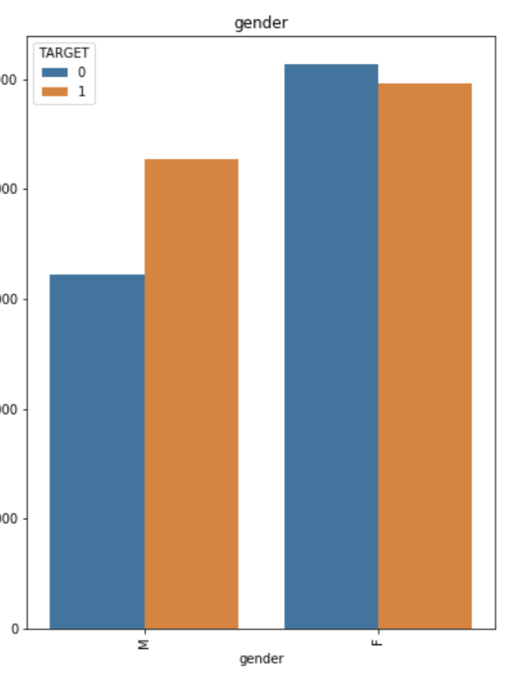
Gender Related
In the category of gender even though men tend to get fewer loans compared to women, they tend to default more than women. This might be just pointing out that a. while men have a better economic conditions they are also the over estimating their finances.

Slide 14
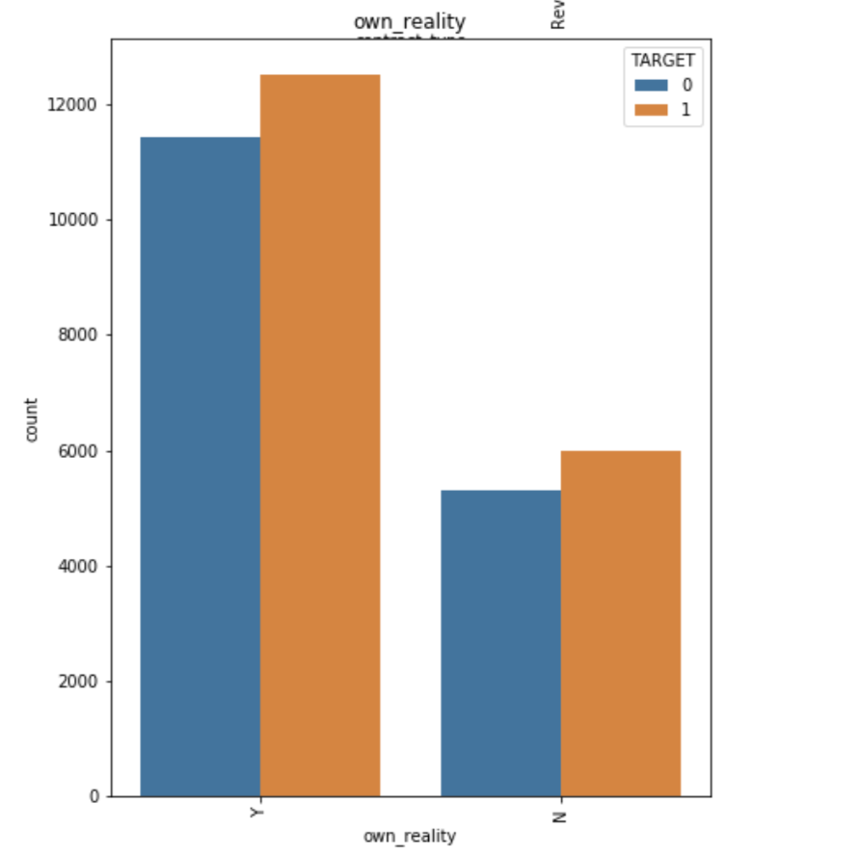
People who own "reality" tend to default more often than not, again indicating that they might be stretching their finances too tight.

Slide 15
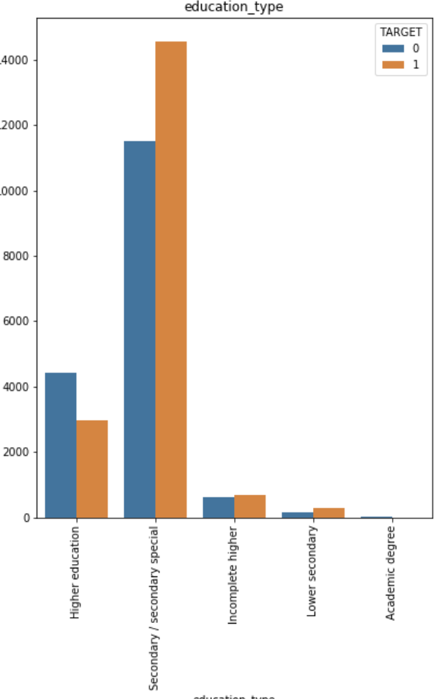
And lower the education level higher is the default rate

Slide 16
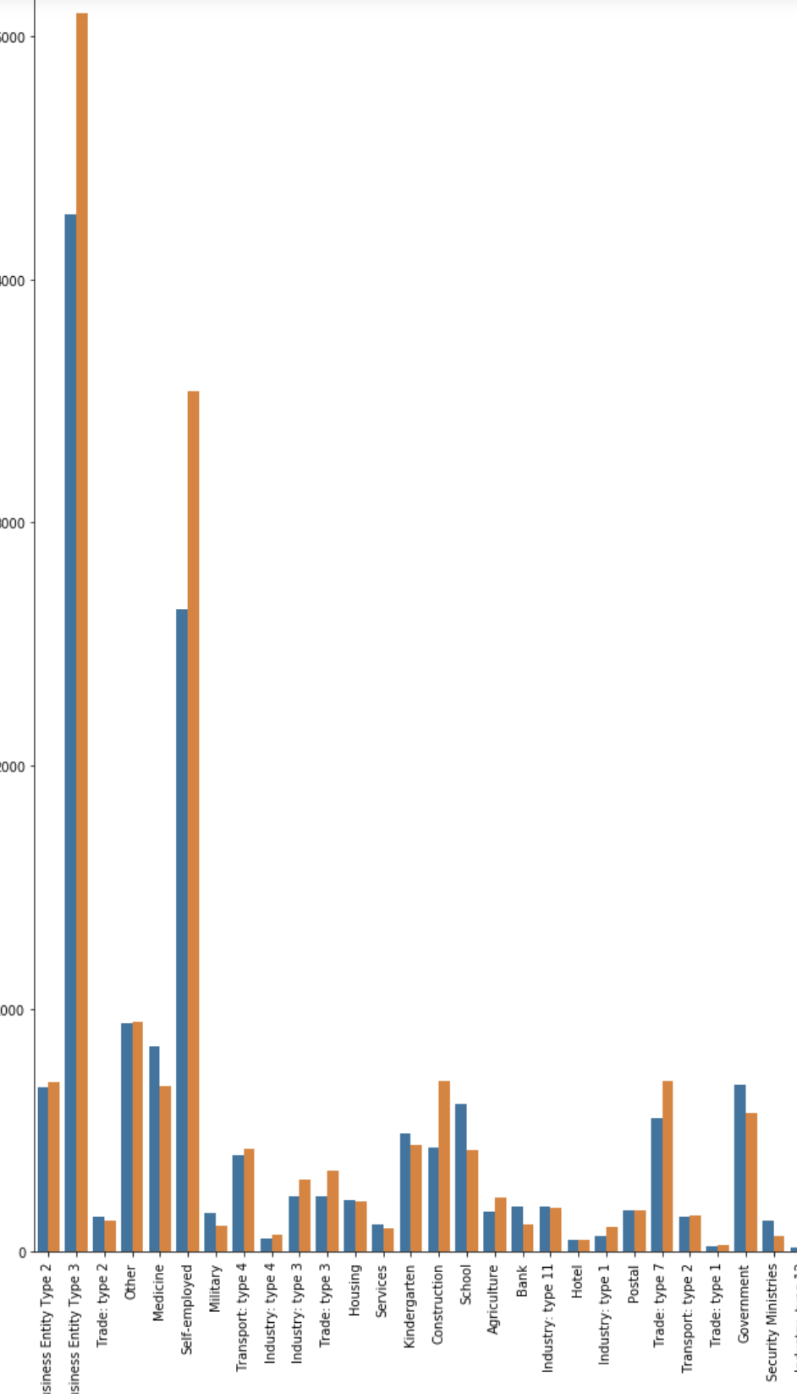
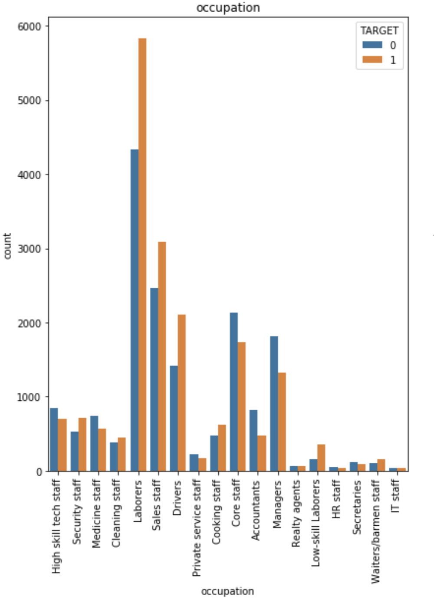
x
This is a biggie, people working in unorganized sectors tend to be the next biggest defaulters and this is evident from both "Occupation_Type" and the ”organization type”

Slide 17
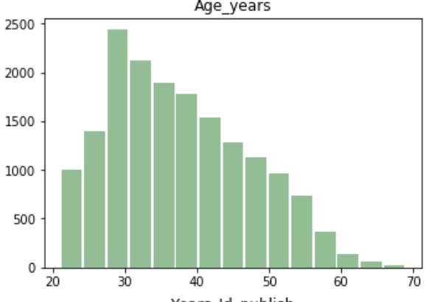
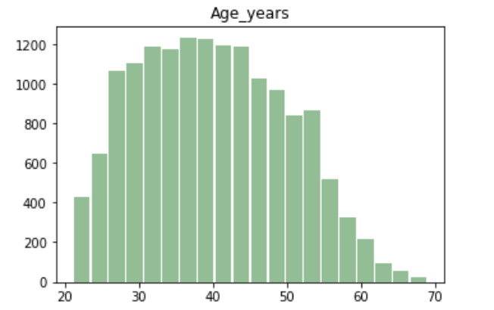
Defaulters are on an average 10 years younger than Non –defaulters
20% more defaulters have their phone changed more recently

Slide 18
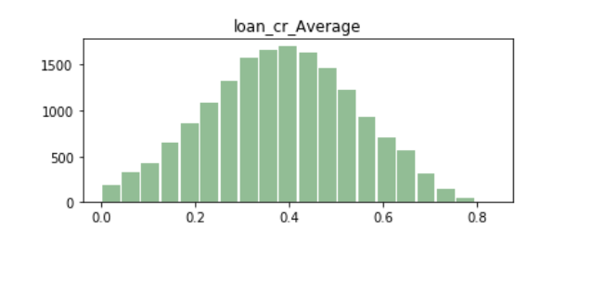
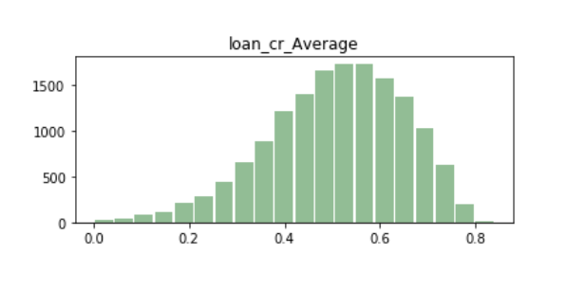
The average credit score of defaulters is 0.15 less than that of the non defaulters
Non defaulters
Defaulters

Slide 19
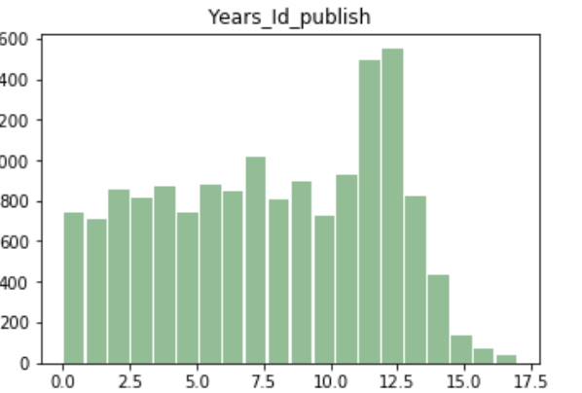
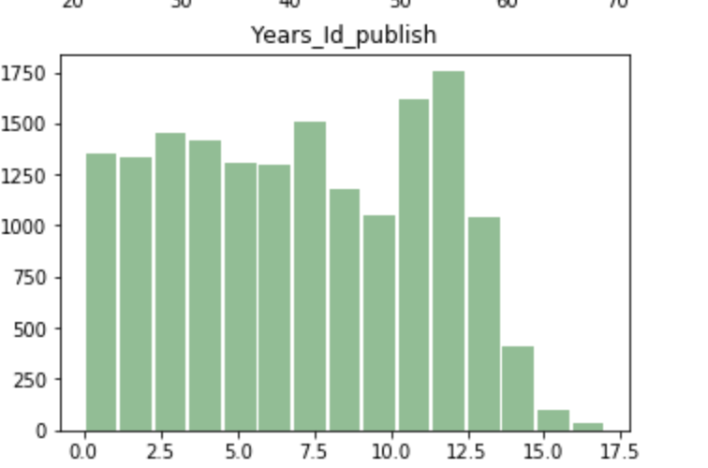


25% more defaulters have their id’s published more recently
Non-Defaulters
Defaulters

Slide 20
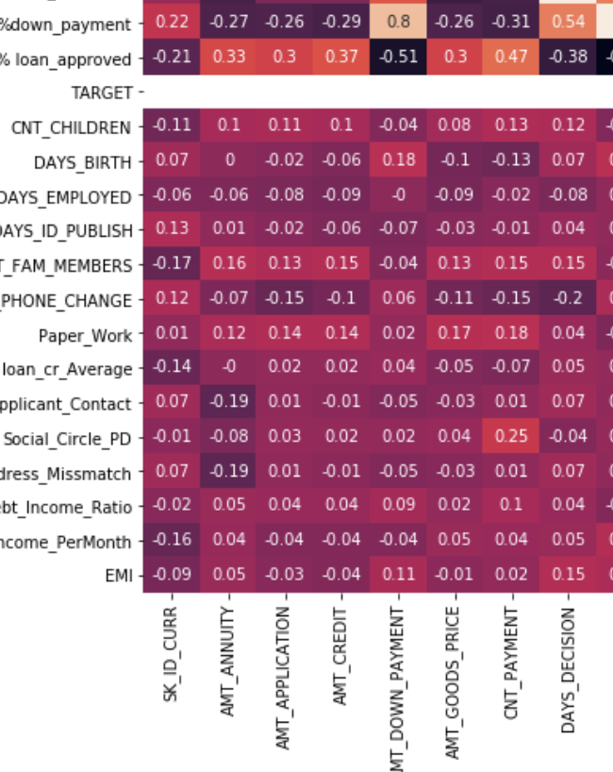
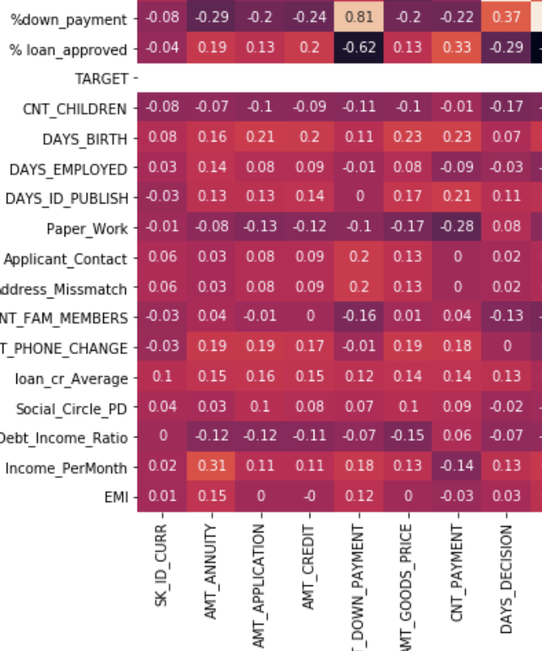



on an average it took longer for the bank to make a decision on defaulters(.54) vs non-defaulters 0.37
Is might due to the applicant taking longer to provide documental evidence
Non-defaulters
Defaulters

Slide 21
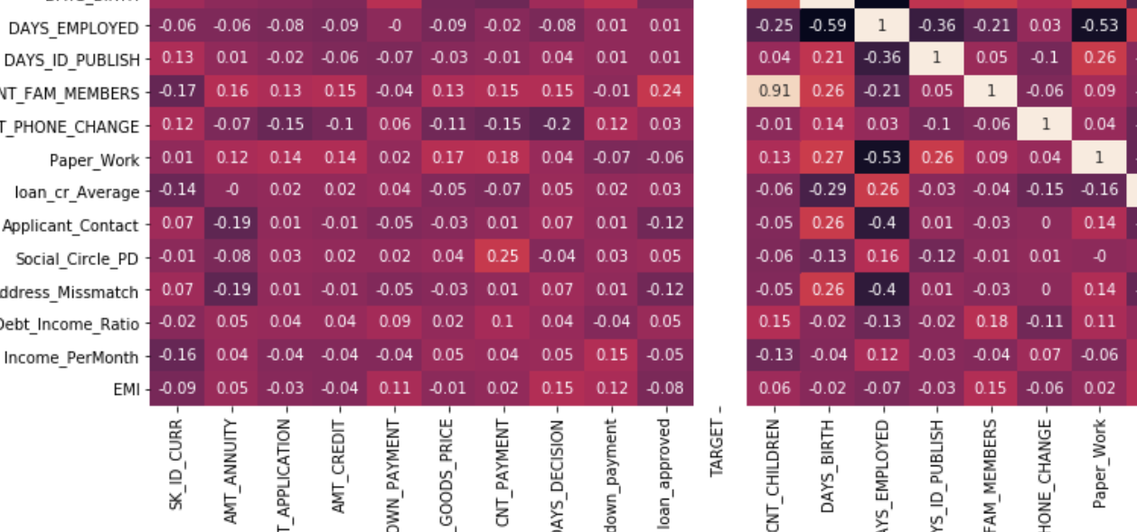
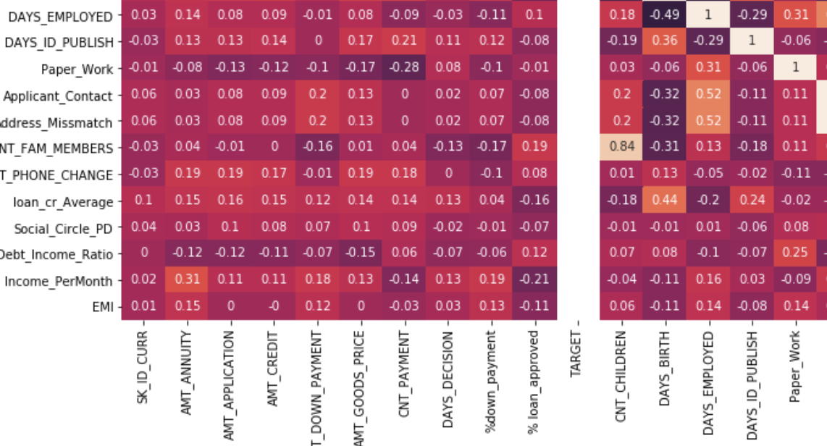


2. when we look at day's employed and amount of paper work turned in we see that defaulters had much less paper work turned in when compared to the non-defaulters.
Defaulters
Non-defaulters

Slide 22
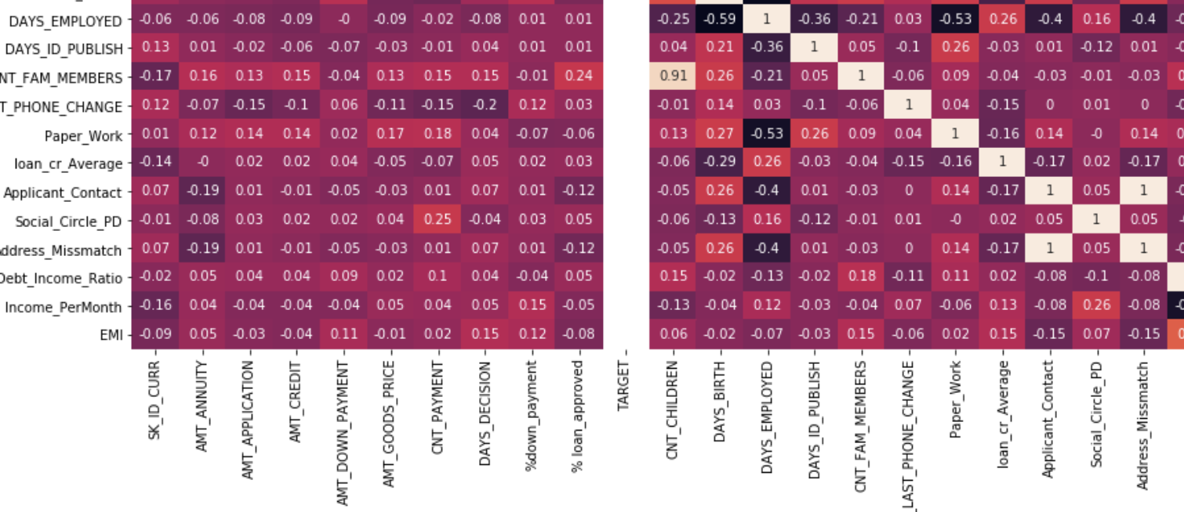
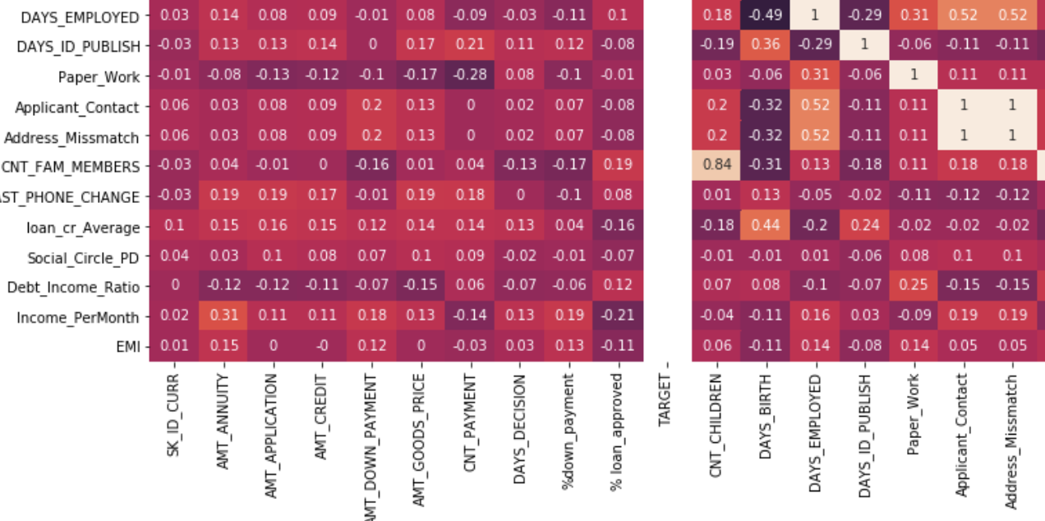

3. The longer the defaulter was employed the more address miss match there is, -0.4 compared to 0.52 for non-defaulters

Slide 23
Doing a good background check may help the bank identify prospective defaulters.
1. on an average it took longer for the bank to make a decission on defaulters(.54) vs non-defaulters
2. when we look at day's employed and amount of paper work turned in we see that defaulters had much less paper work turned in when compared to the non-defaulters.
3. Defaulters had a 0.26 miss-matching address when compared to the non-defaulters at -0.54 in the same age group
4. The longer the defaulter was employed the more address miss match there is, -0.4 compared to 0.52 for non-defaulters

